Slide 1
Sprint 2
MICHAEL TRINH, CHRIS TROUNG, CHASE WALKER

Slide 2
Features added since sprint 1
We added a functional menu consisted of Fast Traveling, Entering a shop to buy said number of items or sell said number to a merchant. We also include the updated stash and gold the user has every time the user is finish with using the shop. Instead of repeated words like for example, if we had a stash of 2 health potions 1 mana potion, 1 stat boost, and 4 ice heals, back then, when you view your stash, it will display health potion, health potion, mana potion, etc... . To fix this, we made a dictionary to count each unique and then display it by item x count so it will return health potion x 2, mana potion x 1, stat boost x 1, and ice heal x 4. Last Sprint, the menu didn’t have the choice to exit since the menu wasn't built yet, this time, you can exit from the game menu.
For this portion of the coding, Michael made write the def function for showStash() and Chris wrote the view stats portion for the menu. Chase wrote the rough draft of the location so you can travel but it will break and return to the menu since it's a WIP. For the shop, we all contributed to writing the buy, sell, show stash, and exiting out of the shop. Chris was responsible for the song choices like always.

Slide 3
Next Sprint
We have a rough draft of the traveling so it is not complete as Chase will continue writing this portion for the next sprint. He will also work on creating a def function for the random pickup system and traveling around the city of Mistvale. Currently, Still trying to see if we should just make it where it's a random encounter or try to implement a system where the user get to choose the direction they want to go. Chris and I will also help with writing the traveling system in the game cause we all know it's going to take a while to write the function for this game.

Slide 4
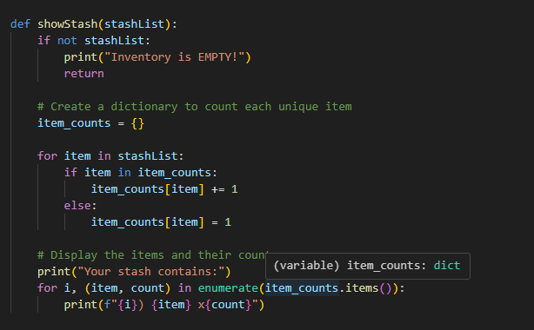
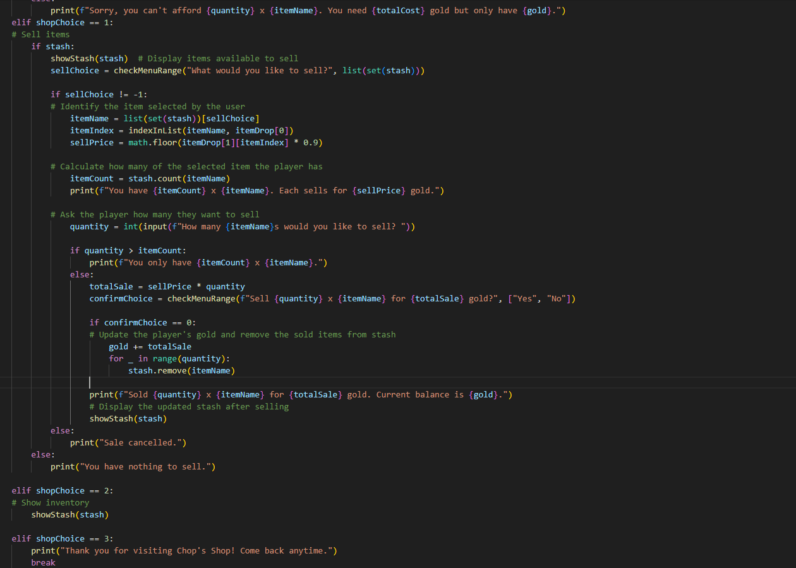
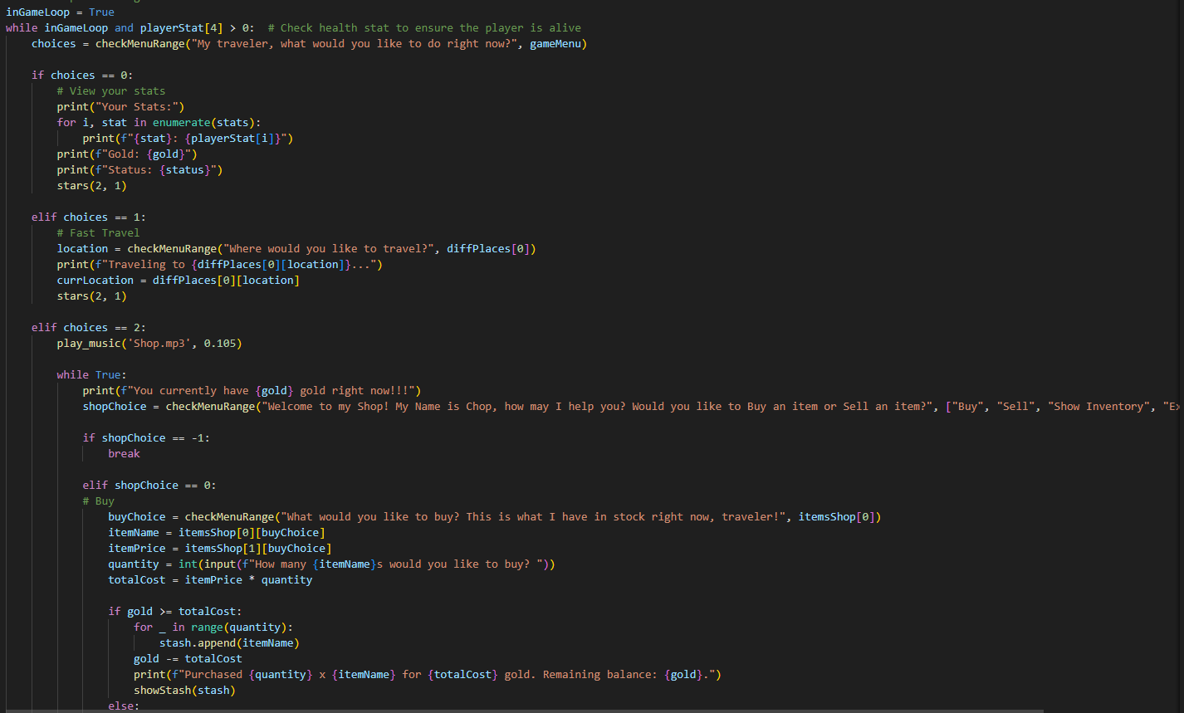
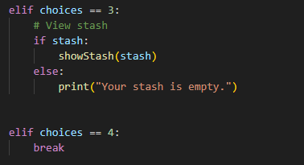
Our code/demo

